Slide 1
http://www.youtube.com/watch?v=0jIlsjJKM2Q
AHS Orchestra Flash Mob (6:26)

Slide 2

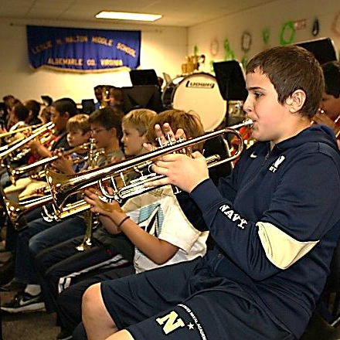
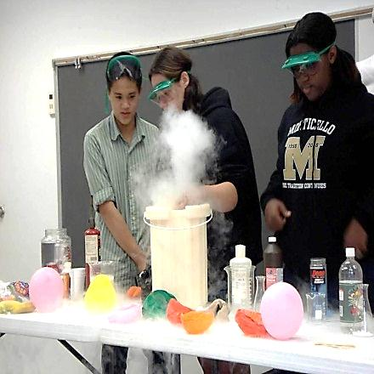
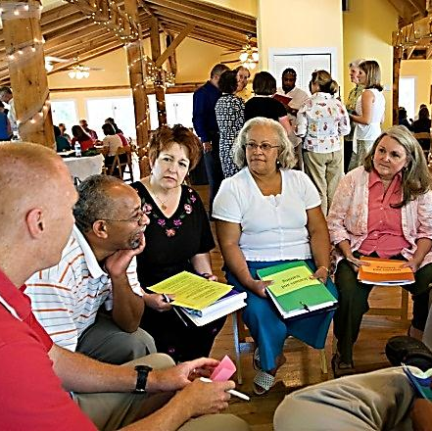
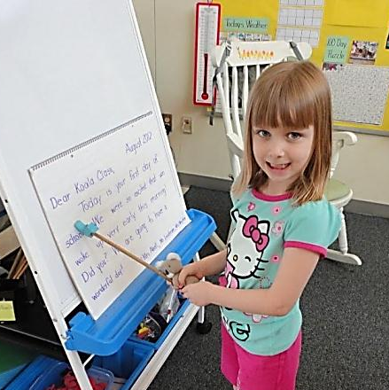
2013-14
Superintendent’s Funding Request
Meeting Students at the Leading Edge of Their Potential

Slide 3

“We choose to go to the moon …
because that goal will serve to
organize and measure the best
of our energies and skills,
because that challenge is one
that we are willing to accept,
one we are unwilling to postpone,
and one which we intend to win ...”
President John F. Kennedy—September 12, 1962
Rice University, Houston, Texas

Slide 4

Moore's law
The observation that over the history of computing hardware, the performance capacity of the computer chip doubles approximately every two years
… the pace of change and progress in education has been far less ambitious.
Notes:
Moore’s law was postulated by Gordon Moore, cofounder of the Intel Corporation, in 1965.

Slide 5
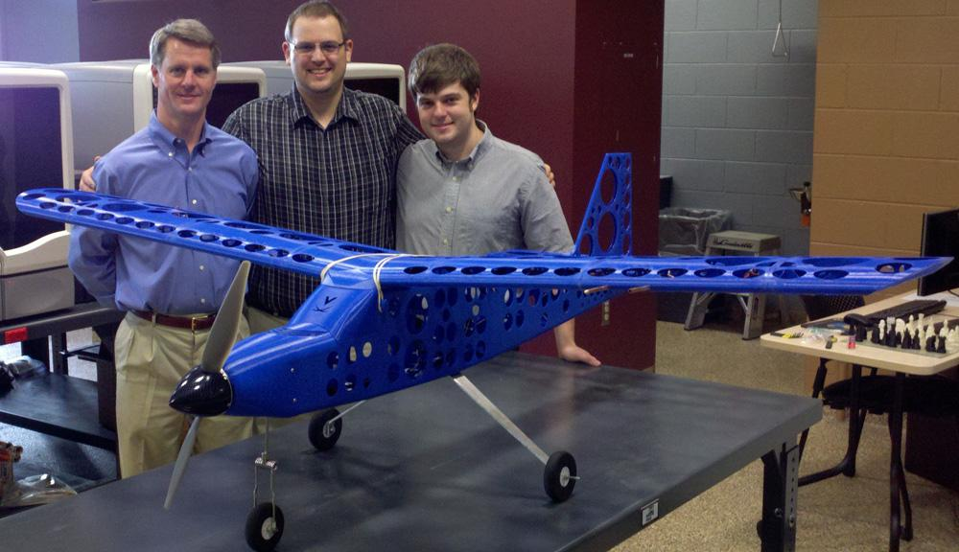
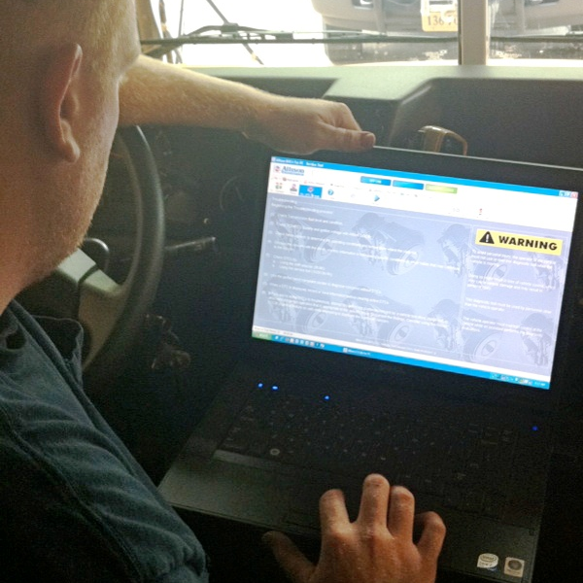


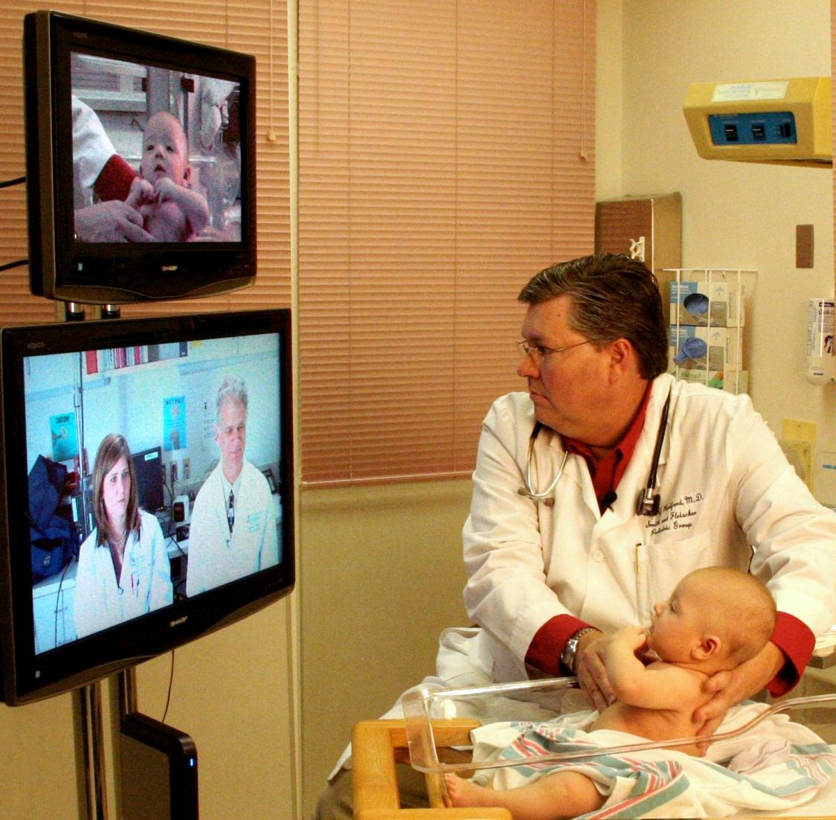

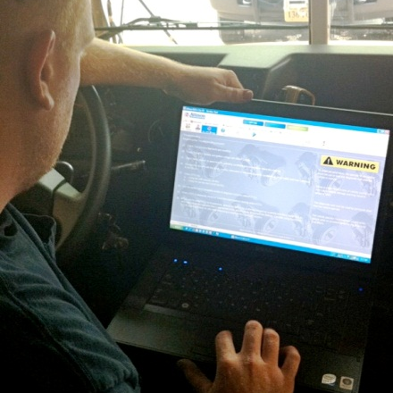

The world around us continues to evolve.
Photo: University of Virginia
Notes:
Click through animation. As you go, tell the story that matches each picture.
More than 37,000 people signed up for UVA’s first global virtual course: "The Modern World: Global History since 1760" is the first of six courses UVa will make available for free this semester through Coursera, an online partnership of more than 30 universities.
Availability of online learning tools: Recently, a local parent was told by a mechanic that repairs on his vehicle would cost $500. He viewed an online video tutorial and did the work himself for the cost of parts ($50).

Slide 6
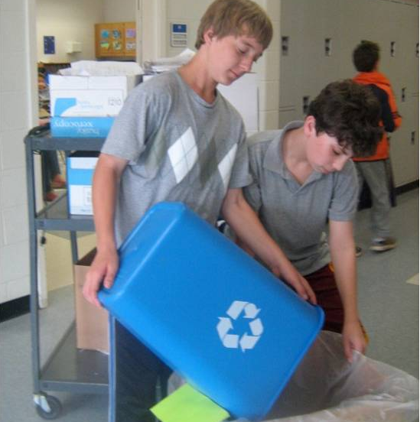
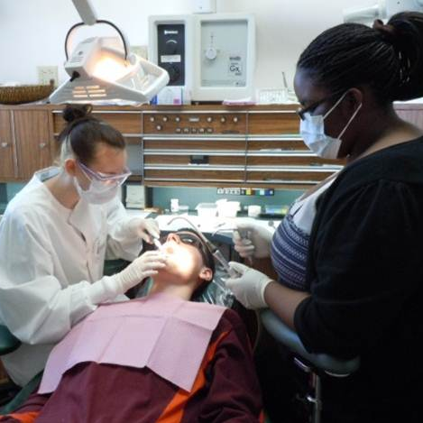
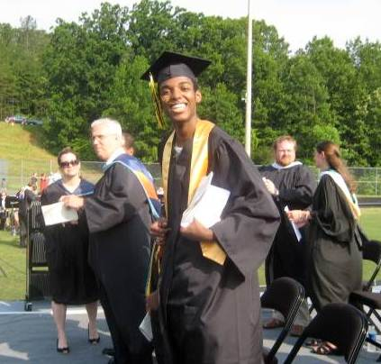
Our aim is for every student in Albemarle County Public Schools to graduate
citizenship, workforce and college ready
with a set of skills that can positively impact our economy and our community.

Slide 7

Sharing Our Successes

Slide 8
In 2012 …
Our students scored among the top 3% of all students in Virginia on the SAT.
66% of our graduates received Advanced Studies Diplomas, over 35% above the state average.
11 of our teachers earned National Board Certification and 36 more are currently undergoing the process.
9 of our schools earned Virginia Index of Performance awards for advanced learning and achievement.
Our talented musicians, thespians and vocalists earned regional, state and even international honors.

Slide 9
Our accomplishments continue …
Our division was one of only 8 in the state to be recognized by the USDA for health and wellness.
Our high school students earned first place finishes in 12 of 14 categories at the regional science fair.
The Virginia Department of Education designated our Health and Medical Sciences Academy as a regional Governor’s Health Sciences Academy.
338 of our middle and high school students participate in AVID (Advancement Via Individual Determination), the division’s college preparatory program.

Slide 10
Climate
Notes:
Transition slide

Slide 11
Current Operational Challenges | Current Instructional Challenges | Watch List
Enrollment growth Local revenue Compensation Bus replacement Redistricting Capital Improvement Program Sequestration | SOQ funding Increased students with F/R lunch State-mandated online testing World Languages Program Graduation requirements Staffing at large elem schools Professional development | 21st Century Learning Safe Schools/ Healthy Students Composite Index Virginia Retirement System

Slide 12
4 Years of Maintenance of Effort Budgets

Slide 13
“Maintenance of Effort” Means …
Funding increases primarily to meet growth and mandates
Fulfilling minimum requirements
Limited opportunities for new initiatives

Slide 14
Our Moon Moment
“Passion rebuilds the world for the youth. It makes all things alive and significant.”
Ralph Waldo Emerson

Slide 15
Design 2015: 21st Century Innovation Lab
Advancing our capabilities in the:
Use of technological resources
Learning environment
Quality of the instructional method
Quality Learning Experience for one learner
Rigor of curriculum
Relevance of content
Relationships to learning resources
Notes:
What is a Design 2015 Learning Grant?
Utilizing the Plan-Do-Study-Act model, the division will allocate funding for innovative approaches to instruction and, in turn, elevated learning for all students.
3 Categories:
Single classroom impact
School and organizational impact
Division and organizational impact

Slide 16
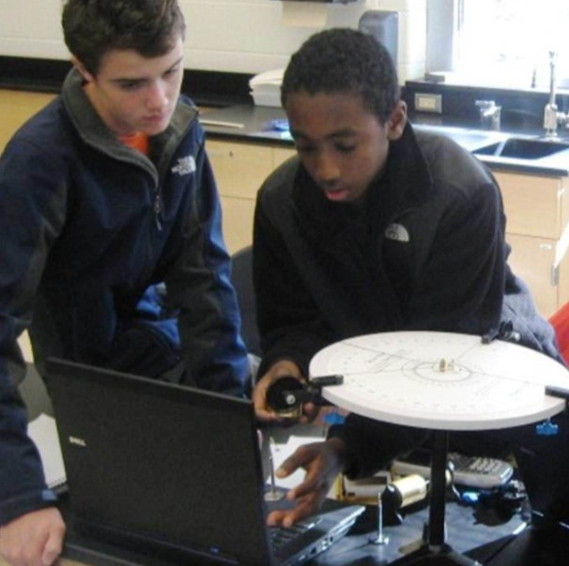
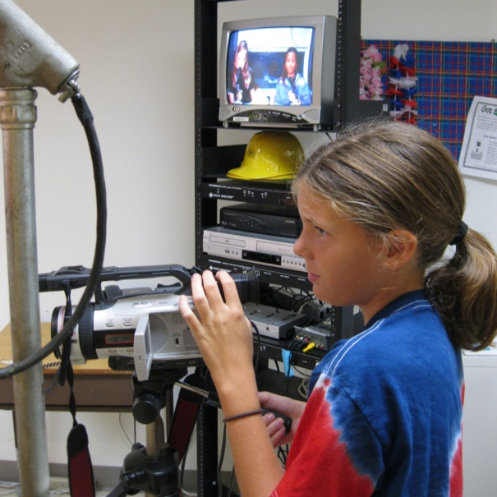
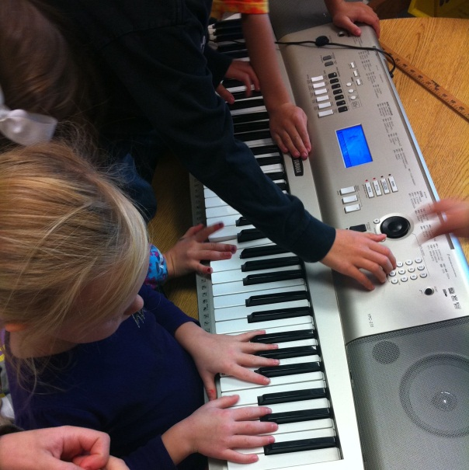
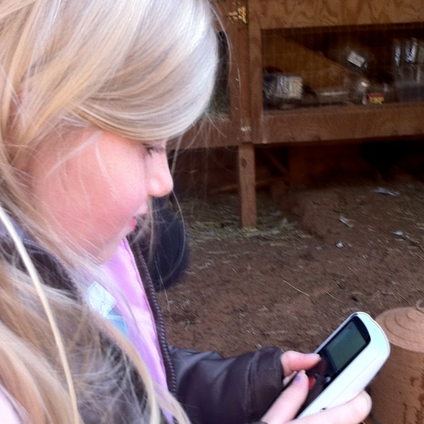
Critical thinking
Implementing the
4Cs
Collaboration
Creativity
Communication
Notes:
This funding request is built upon the foundation of the “3Rs,” to which it adds “4Cs.” Education must continue to be about Reading, wRiting and aRithmetic, and also be about Critical thinking, Creativity, Collaboration and Communication.

Slide 17
Funding Request
Notes:
Transition slide

Slide 18
Total Funding Request (in millions)
Anticipated Revenue | $153.97
Proposed Expenses | $155.44
Funding Gap | ($1.47)
2013-14 Revenue Sources

Slide 19
Revenues (in millions)
 | 2012-13 Adopted | 2013-14 Proposed | $ Change
Local – Schools | $1.59 | $2.05 | $0.46
State Revenue | $42.95 | $43.32 | $0.37
Federal Revenue | $2.94 | $2.94 | $0
Local – General Fund Transfer | $100.11 | $102.62 | $2.51
Other Local Transfers & Fund Balance | $3.67 | $3.05 | ($0.62)
 | $151.25 | $153.97 | $2.72

Slide 20
Expenses (in millions)
 | 2012-13 Adopted | 2013-14 Requested | $ Change | % Change
Instruction | $114.84 | $118.17 | $3.33 | 2.90%
Admin, Attendance & Health | $6.80 | $6.88 | $0.08 | 1.28%
Transportation | $8.84 | $9.36 | $0.52 | 5.85%
Building Services | $14.52 | $14.92 | $0.40 | 2.75%
Technology | $2.43 | $2.71 | $0.03 | 11.68%
Transfers | $3.83 | $3.40 | ($0.42) | - 11.09%
 | $151.25 | $155.44 | $4.20 | 2.77%

Slide 21
Systemic Assumptions
VRS rates for 2013-14 hold steady at 12.77%
Overall enrollment will increase
Free/reduced lunch numbers have increased; future projections assume current levels will remain constant
2% salary increase for employees
School bus replacement costs will be moved from the operational budget to the CIP
Class size and scheduling changes have budgetary impacts
Notes:
We are proposing 2% pay-for-performance increase for classified staff based upon the recommendations presented to the Joint Boards last fall.
Taking into account the Governor’s recommendation, we also are proposing an increase of approximately 2% across our teacher pool. Fully funding the Governor’s recommendation will cost the division $40,000, which will qualify us to receive another $380,000 in state aid.

Slide 22
Addressing Our Needs:
Summary of Tier 1 Initiatives
Instruction | $248,135
Maintenance of Effort (primarily to support enrollment growth and mandates) | $3,198,210
Market Competitiveness (to support recruitment and retention of highly-qualified workforce) | $3,271,527
Budget Reductions | ($3,457,602)
Total for Tier 1 Initiatives | $3,260,270

Slide 23
Maintenance of Effort
$3,198,210
Growth Due to Enrollment 23.64 FTE - $1,483,528; $43,996
Transfer to Comprehensive Services Act (CSA) $500,000
Piedmont Regional Education Program (PREP) $258,942
Return of School Capital $226,978
Projected Donations $180,647
Special Education Staffing 2.50 FTE - $167,467
Capital Improvement Program (CIP) Storage Lease $144,000
Charlottesville Albemarle Technical Education Center (CATEC) $107,701
Increase Staffing to Support English for Speakers of Other Languages (ESOL) Students 1.00 FTE - $66,987
Increases in Wireless Costs $60,000
Department of Social Services/Bright Stars Increase $1,960

Slide 24
Instruction
$248,135
Virtual Courses 1.00 FTE - $66,987; $181,148
Market Competitiveness
$3,271,527
Teacher Salary Increase $1,491,955
Classified Salary Increase $946,289
Health Insurance Increase $799,820
Dental Increase $33,463

Slide 25
Reductions
($3,457,602)
Lapse Factor Increase ($1,500,000)
Bus Replacement Moved to Capital Improvement Program (CIP) ($947,896)
Salary Savings ($735,168)
Eliminate Transfer to Adult Education Grant ($22,500)
Voluntary Early Retirement Incentive Plan (VERIP) ($252,038)

Slide 26
Educational Excellence
Meeting Students at the
Leading Edge of Their Potential
Notes:
Transition slide

Slide 27
What Educational Excellence Looks Like
Implementation of a fully staffed instructional coaching model
Development and implementation of a full one-to-one technology initiative
Development and implementation of a world languages program in elementary schools
Year-round opportunities for teachers to design lessons and assessments consistent with the Framework for Quality Learning and 21st century learning skills and competencies
Provision of direct home-to-school transportation for our high school magnet programs
Transformation of classrooms into innovative learning environments

Slide 28
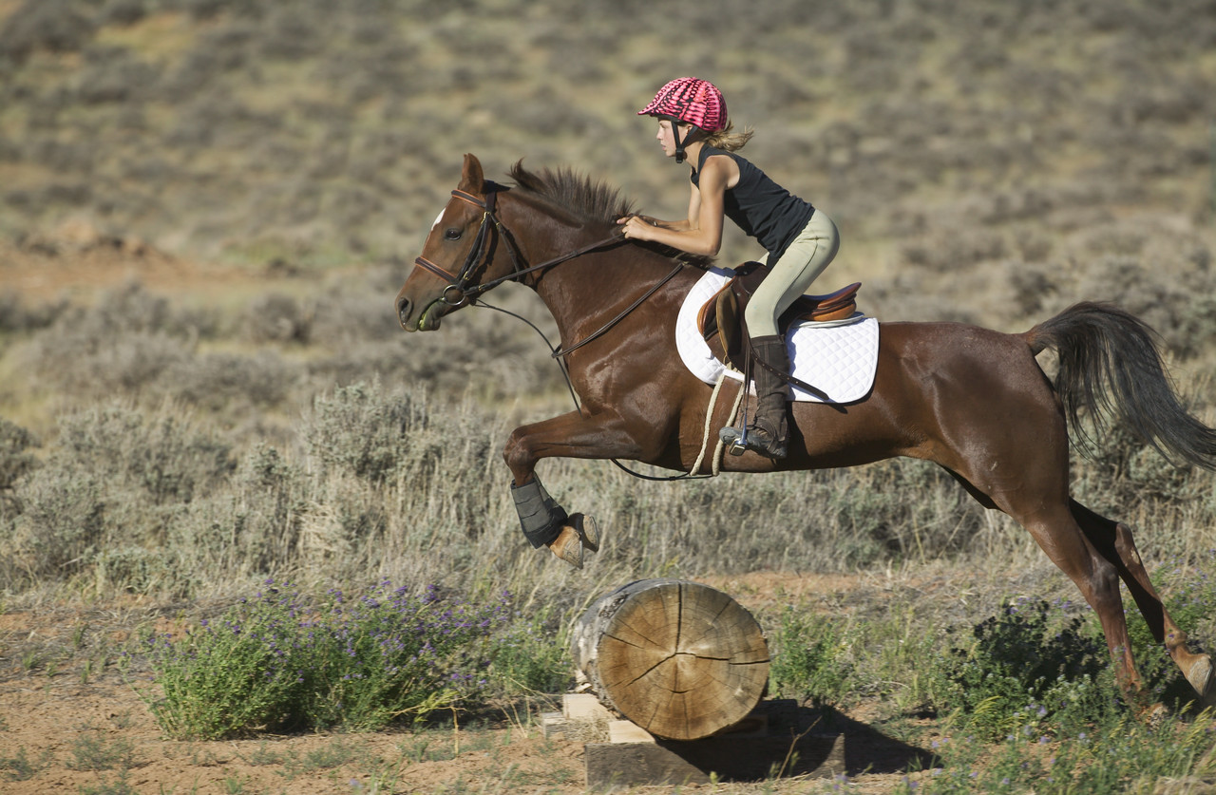
one
student at a time

Slide 29
Thank You to Our Contributors
AEA Exchange
County Parent Council
County Student Council
Classified Employee Advisory
DART Advisory
Gifted Advisory
Leadership Team
Long Range Planning Advisory
Quality Council
School Finance Advisory Council
School Health Advisory Board
Special Education Advisory
Superintendent’s Budget Advisory
Teacher Advisory
www.k12albemarle.org/budget

Slide 30
Budget Development Calendar
January | February | March | April
22 – Budget WS; Supt’s Budget Request Presentation 24 – Regular Board Mtg & Budget WS 31 – Public Hearing: School Budget; Tentative Budget WS | 5 – Budget WS 7 – Tentative Budget WS (if needed) 14 – Regular Board Mtg (Finalize SB’s Request) 25 – Public Hearing on County Exec’s Recommended Budget 28 – Regular Board WS | 4 – BOS Budget WS: General Gov’t 7 – BOS Budget WS: CIP 11 – BOS Budget WS: School Division 13 – BOS Budget WS (if needed) 14 – Regular Board Mtg 27 – Public Hearing: Calendar Year Tax Rate and Proposed Op & Cap Budgets 28 – Regular Board WS | 3 – BOS adopts 2012-13 Budget and 2013-14 Calendar Year Tax Rate 11 – Regular Board Mtg/Budget Discussion 18 – Tentative Budget WS (if needed) 25 – Regular Board WS: Adopt Budget

Slide 31
Future Budget Work Session Schedule
January 22 | Receive Superintendent’s Funding Request Overview of Request – Jackson Zimmermann Instructional Departments – Billy Haun
January 24 | DART & Technology – Vince Scheivert Operations Departments – Josh Davis
January 31 | Public Hearing
February 5 | Human Resources – Lorna Gerome Other items identified by the Board
February 7 | Tentative
February 14 | Adopt a Request

